Slide 1





MODULE-1
PERSONAL INFORMATION
Presented by: Disha Khunt

Slide 2


Hello,
I am Disha Khunt.
BRIEFLY INTRODUCE YOURSELF: NAME, EDUCATIONAL BACKGROUND, AND CURRENT STATUS (STUDENT OR PROFESSIONAL).
I completed my graduation in BE Computer Engineering from Government Engineering College, Rajkot.
I am currently doing an internship at Inbox Technology.
I am working on the online course registration system project, which uses PHP technology.

Slide 3

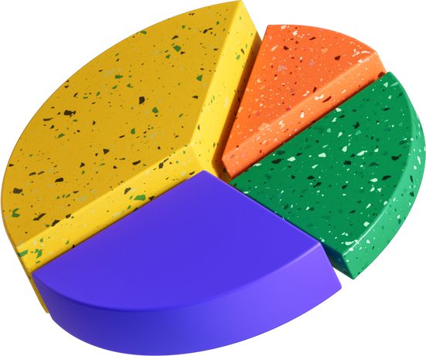
EXPLAIN YOUR INTEREST IN TECHNOLOGY AND WHY YOU CHOSE THIS CAREER PATH.
I have problem-solving skills. I use critical thinking, decision-making, and creativity to find solutions to any problem.
I have analytical skills because I can analyze situations properly and organize them effectively.

Slide 4
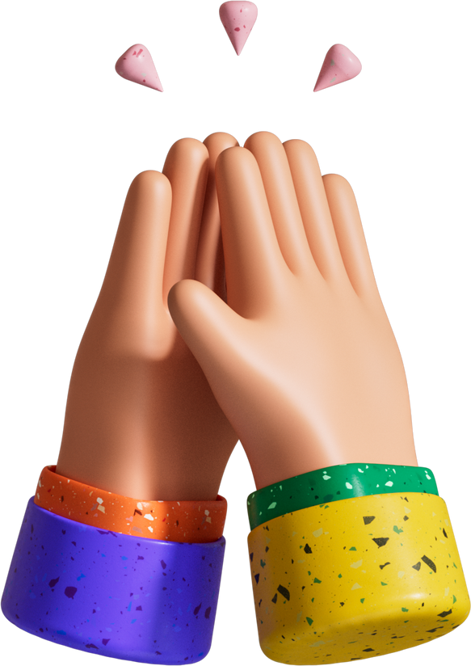
MENTION KEY PERSONALITY TRAITS, SUCH AS YOUR CREATIVITY, ANALYTICAL SKILLS, OR PASSION FOR PROBLEM-SOLVING.
I am particularly interested in the MERN stack technology because it allows for efficient, full-stack development and the creation of dynamic web applications.

Slide 5
THANK YOU

